Slide 1

Key Themes from the Program
Paula Griswold
Executive Director
Massachusetts Coalition for the Prevention of Medical Errors
Yvonne Cheung, MD, MPH
Chair, Department of Quality and Safety & Chief Quality Officer
Mount Auburn Hospital
Coalition Board President

Slide 2

Organizational Strategies to
Accelerate Improvement
Integrate performance improvement -goals
  Patient safety/Reliability:
  providing effective care – do the right thing every time
  Quality /evidence-based care
  Patient-centered care
  Efficiency – reducing waste/improving value
  Worker Safety
  Reduce Clinician/staff burnout – reducing wasted time
  Joy and Meaning in work - engaging staff in change
  Across system - Care coordination & population health

Slide 3
Organizational Strategies to
Accelerate Improvement
Integrate performance improvement goals
“Quality” as a business strategy
Meeting customers’ needs without waste

Slide 4
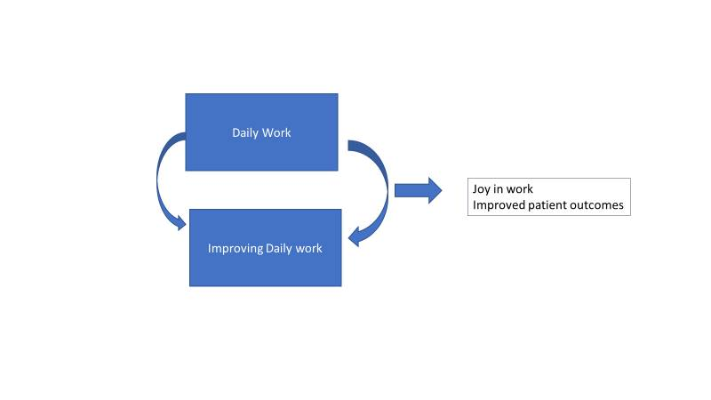

Slide 5

Strategies for Accelerating Improvement: Framework
Leadership
Culture
Learning System for Process Improvement
Patient and Family Engagement
Staff Engagement

Slide 6
Today
Continue to provide models:
Framework for organizational transformation to accelerate improvement
Agenda:
Organizational strategies
Improving diagnostic process
Engage you in giving feedback
  What would help you make these changes in your organization

Slide 7
Building a Massachusetts Partnership to Accelerate Improvement
Partner with other organizations in the state
Continue to learn from each other:
  Share strategies, critical success factors, curriculum
  With healthcare leaders and patients and families
Designing systems for staff engagement in improving work – toward all goals

Slide 8

Please remember to turn in your
evaluation,
feedback form
name badge
Physicians can pick up CME certificates as you leave;
Nursing, pharmacy and CPPS certificates will be emailed
Thank you!

